Slide 1
BIG MOUNTAIN PRICING RESTRUCTURE
by Paris Vu

Slide 2
BUSINESS QUESTION
What opportunities exist for Big Mountain Resort to decrease operational cost to
revenue ratio immediately by restructuring its ticket pricing based on existing
facilities?

Slide 3
RECOMMENDATION AND KEY FINDING
Big Mountain resort located in the state of Montana, USA should increase their weekend ticket price from $81 to $95.87

Slide 4
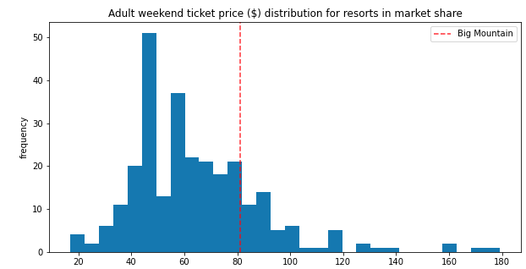
BIG MOUNTAIN IS UNDERCHARGING
Big Mountain’s current pricing is at the top of its state (Montana), but it isn’t within the top 5 within the USA. Given its provided facilities, Big Mountain resort is definitely undercharging nationwide.

Slide 5
CUSTOMERS PREFERENCE
The following were found to be the key factors in customer’s satisfaction and Big Mountain is standing at the top of each factor: 1. Vertical drop (how high the hill is)
2. Snow making capability
3. Total chair lift
4. Fast quad (4-seated chair lift)
5. Runs (slope or trail suitable for skiing)
6. Skiable terrain

Slide 6
ADDING A TRAM
One key factor that Big Mountain did not have is resort tram. Although having no trams like most resorts, Big Mountain should consider installing one due to its positive correlation with the weekend ticket pricing. It would also boost our confidence in increasing ticket price since only 1/9 of US resorts provide tram within their facilities.

Slide 7
$95.87 is still not the max.
Given that this model was built upon the best dataset, pricing could also increase by another $10.39 to maximize Big Mountain’s revenue. Furthermore, with Big Mountain standing at the right hand side of almost every facilities that it provides, we are confident that $10.39 is a good estimate for leverage.

Slide 8
SUMMARY
Currently, Big Mountain has amongst the highest number of total chairs, resorts with more appear to be outliers. With the initial question of whether or not to install another chairlift, Big Mountain will only have to raise the price by $1.99 per ticket to cover the additional cost. Given that their revenue will increase by $3,474,638 by increasing the weekend ticket price from $81 to the suggested pricing of $95.87, Big Mountain Resort has plenty of room to consider this installation.

